Slide 1
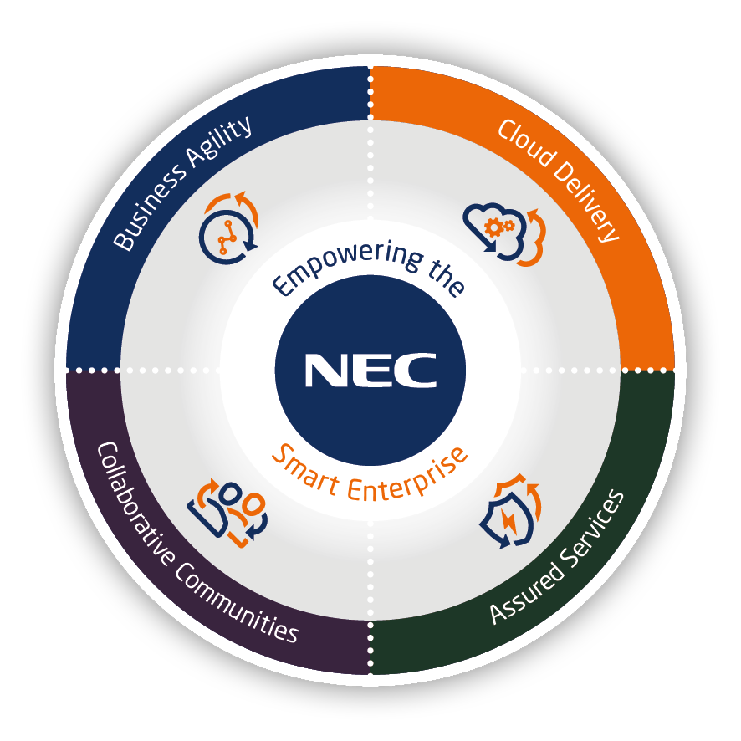
UNIVERGE SV9100 Reasons to Migrate from an SV8100

Slide 2
Contents
Reasons to migrate

Slide 3
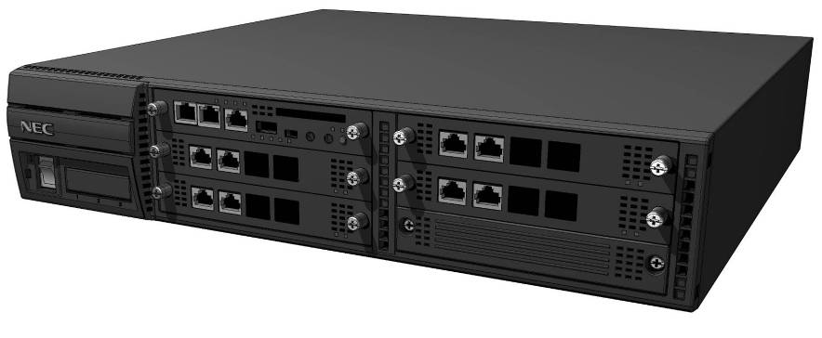
UNIVERGE SV9100 – Reasons to Migrate from an SV8100
Reasons to migrate from an SV8100 to an SV9100
The SV8100 was available from 2008 to 2014 when it was replaced by the SV9100 system. SV9100 offers these benefits to an existing SV8100 customer: Infographic-nec-sv9100-upgrade-10reasons.pdf Software Assurance – Includes upgrades to the Main Software and version license release at 6 month intervals Infographic_SV9100_Software_Assurance_5_Reasons_NEC_eng_2015.pdf Capacity Increase – The SV9100 supports a much larger system port capacity Trunk capacity increased from 200 to 400 Extension capacity increased from 512 to 896 IP resources increased from 128 to 256 System configuration increases for DDI tables, Speed Dials, Netlink Nodes, InMail storage Multiple SIP carriers – Increased from 1 to 6 InUC – Built-in Browser based Unified Communications including Video and Audio Conferencing, Document sharing, IM, Presence, Deskphone Control and Browser phone 128 InUC users 4 Video conferences each of up to 8 members (4 web video licences included free of charge) infosheet-NEC-InUC-eng-01-2018(10-233-02).pdf
SV8100
SV9100

Slide 4
UNIVERGE SV9100 – Reasons to Migrate from an SV8100
Reasons to migrate from an SV8100 to an SV9100
Latest On-board Applications InGuard - infosheet-NEC-InGuard-eng-01-2018(10-239-02).PDF InReports - infosheet-NEC-InReports-eng-08-2018(10-237-03).pdf InHotel - infosheet-NEC-InHotel-eng-06-2018(10-240-05).pdf InUC - infosheet-NEC-InUC-eng-01-2018(10-233-02).pdf InDECT - infosheet InDECT 1.3 Re-use most of your existing SV8100 hardware Chassis Interface cards Terminals Overview - Replication of SV8100 to an SV9100 CP20 rev1.0.pdf InMail storage capacity increased from 32hour to 115hour Storage capacity determined by the SD-A1 (12hour) / SD-B1 (115hour) memory card installed onto the CPU card VoIP Resources increased from a maximum of 128 to 256 The SV8100 has a choice of IPLB cards with either 32, 64 or 128 resources available The SV9100 has a single IPLE card that supports up to 256 resources. Resource license is included with each IP device license.

Slide 5
UNIVERGE SV9100 – Reasons to Migrate from an SV8100
Reasons to migrate from an SV8100 to an SV9100
Updated user interface for the DT range of terminals with improved Navigation Key menus Peer to Peer mode setting is port based, SV8100 is system based NAT Traversal for Standard SIP terminals, SV8100 supports NAT Traversal for DT range IP terminals only Support Conference key on standard SIP terminals Maximum VRS recording duration increased from 2 minutes to 4 minutes per message Capacity licensing changed from a stepped method to a linear method SV8100 uses a combination of hardware (PZ-ME50) and 256/unlimited ports capacity licenses SV9100 uses a port capacity license for each trunk/extension for ports 64 and above. Ports 1 to 64 do not require a capacity license SV9100 has 4 SIP trunks, 4 IP extension and 4 Mobile extension licenses included Prophix can be used to migrate an existing SV8100 system to an SV9100. The Hardware Key Code of the SV8100 is required, Prophix will generate a parts list of the required SV9100 hardware and licenses to migrate the system User Guide - Replication of SV8100 to an SV9100 rev1.3.pdf

Slide 6
Notes:
＃About use of this slide
NECグループのブランドステートメント「Orchestrating a brighter world」は、ステークホルダーへの約束として、NECグループの企業姿勢、実現したい世界観と、それに対する自らの「行動・能力」を表現したものです。
社外向け発信活動においては、必ず表紙の次ページに本スライドを挿入し、ブランドステートメントとともにどんなストーリーを展開するかを説明するように心掛けてください。
＜セリフ例＞-----
私たちNECグループは、お客さまや社会と共創して、社会価値を創造していきます。
人が生きる、豊かに生きる、そして明るい未来につなげていくために。
これをブランドステートメント「Orchestrating a brighter world」としました。
NECグループが目指しているこの方向性の中で、本日は、○○○を実現する具体的な取り組み（ソリューション、サービス、技術）についてご説明します。
-----------------
※そのほか、言葉に込めた意味、マークデザインに込めた意味については、「NEC Brand Principles」で確認してください。

